Slide 1



Trio: Utilizing Tag Interference for Refined Localization of Passive RFID
Han Ding*, Jinsong Han*, Chen Qian⁺, Fu Xiao※,
Ge Wang*, Nan Yang*, Wei Xi*, and Jian Xiao#
* Xi’an Jiaotong University, China
⁺ University of California Santa Cruz, USA
※ Nanjing University of Posts and Telecommunications, China
# Chang’an University, China
Notes:
1
Good morning, everyone. My name is Han Ding, an assistant professor from Xi’an Jiaotong University.
This is a joint work Prof. Jinsong Han, Prof. Chen Qian, and Prof. Pu Xiao.
I am happy to be here to present our recent work, Trio: Utilizing Tag Interference for Refined Localization.

Slide 2


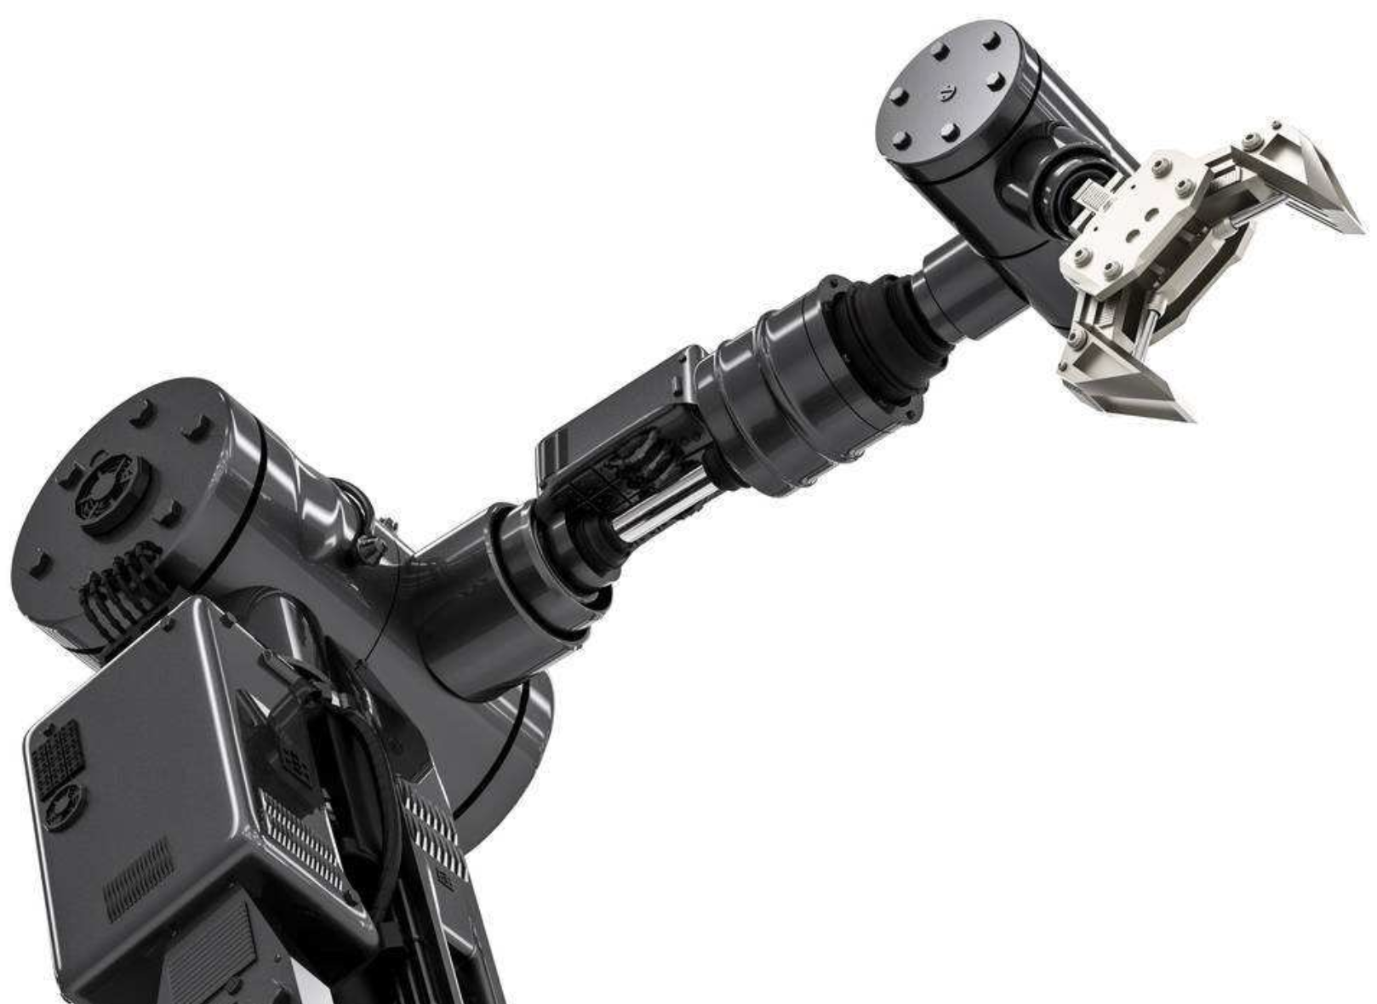


Refined Localization
Localize an object in high precision, given that the object is in a relatively small region.
Require good lighting conditions
Line-of-sight
Pre-learning process
Not applicable to
similar objects
Vision based approaches
Autonomous robots
Notes:
As we know, Localization technique can benefit many applications, and a lot of research have been conducted in this area.
But today, we will talk about the refined localization problem. That is, Given a number of objects in a small region, such as the surface of a table or space in a shelf, refined localization problem calculates the location of each object in this region with very high accuracy.
Refined localization is useful in many cyber-physical systems, for example the autonomous [ɔ'tɑnəməs] robots. An industrial robot arm needs to perform accurate motions within its working space, such as grasping, lifting, or carrying items. To achieve this goal, the robot first needs to know which object is the target, and then it can perform its specific mission.
Existing approaches for above task mainly depend on computer vision techniques. They use vision sensors to capture the pictures of the target and get its location. However, using vision sensors have some limitations. They require good lighting condition and line of sight. What’s worse, they will fail [feɪl] when detecting or recognizing objects with similar colors or shapes.
Considering that massive similar objects are quite common in practice, such as in supermarkets, warehouses, and so on.

Slide 3
Refined Localization
Can we solve these problems
using RFID systems?
Localize an object in high precision, given that the object is in a relatively small region.
Require good lighting conditions
Line-of-sight
Pre-learning process
Not applicable to
similar objects
Notes:
So we ask a question, can we solve these problems using RFID systems?

Slide 4

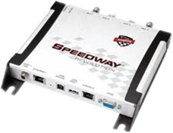
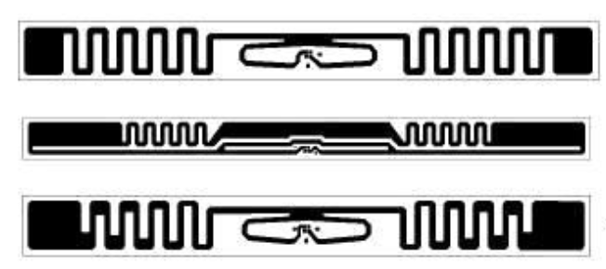
RFID Features
R T
UHF Passive Tags
Battery-free, low-cost
None-line-of-sight access
Tag is vulnerable to local environment (Nearby tags)
T R
Notes:
In UHF RFID system, tags utilize the backscatter mechanism ['mɛkənɪzəm] to communicate with the reader.
They are battery-free and low-cost, suitable for large-scale deployments.
Every tag has an unique ID to represent a specific item and can achieve none-line-of-sight access. So it can naturally solve the problem of recognizing items with similar colors and shapes.
More important here is that tag’s signal is vulnerable to local environment, especially nearby tags.
This is a phenomenon that we usually want to avoid [ə'vɔɪd] in practice, but it is the key to win in our system.

Slide 5

Our Idea
Trio: RFID-based system
Light-weight
Cost-efficient
Thinking different
Leveraging coupling effect of tags
Vulnerable
to nearby tags
Notes:
Inspired by above features, in this paper, we propose a light-weight and cost-efficient RFID based system for refined localization.
The main idea is based on the fact that there exist coupling effects among nearby tags.

Slide 6


Our Idea
Trio: introducing two reference tags
Absolute localization
Relative localization
Scattering power
Notes:
Let’s see an example. If there is no nearby tags around, the scattering power of the target tag will remain almost constant.
Trio introduces a pair of moving tags as the reference tags. When the reference tags move close to the target, they will affect the electric [ɪ'lɛktrɪk] fields of the target tag, then change its antenna structure and of course yield variation of its scattering power.
So we can utilize this effect and observe the power variation to localize the target in a small region.
Trio is able to conduct two localization missions, absolute localization and relative localization.

Slide 7
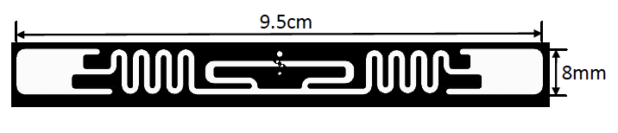
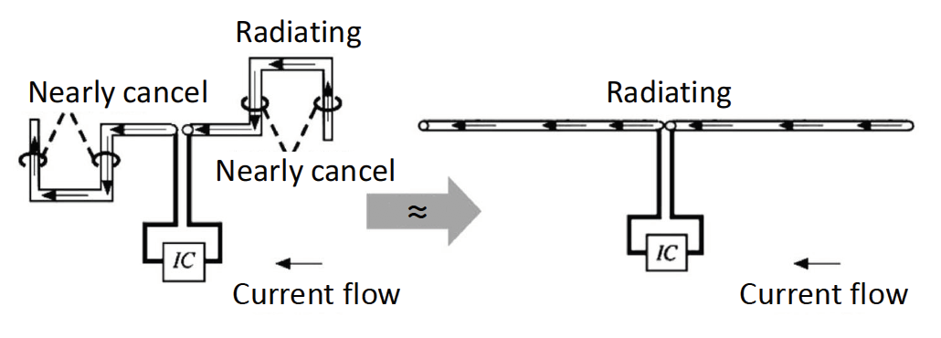
Modeling Tag Coupling
Tag antenna model
Meandered dipole
Currents and radiation
Antenna wires
IC
Notes:
For better understanding the interference among nearby tags, we build a multiple tag coupling model.
Let’s first introduce the tag model. A tag is composed of the antenna wires and the IC.
The antenna design is related to its communication frequency. Typically, UHF passive tags adopt the half-way dipole-shaped antenna, which means the length of the antenna should be about 16cm. This length is not practical for tags to attach on real objects.
Hence, the wires of tag antenna are usually bent, which we call it me`andered [mɪ‘ændɚ] dipole, because it looks like a river menandering across a flat plain. This kind of design can shorten the tag length to about 9cm, which is more suitable for real deployment and this is the tag we adopted in our system.
//The currents flows in antenna wires radiate the power out.

Slide 8
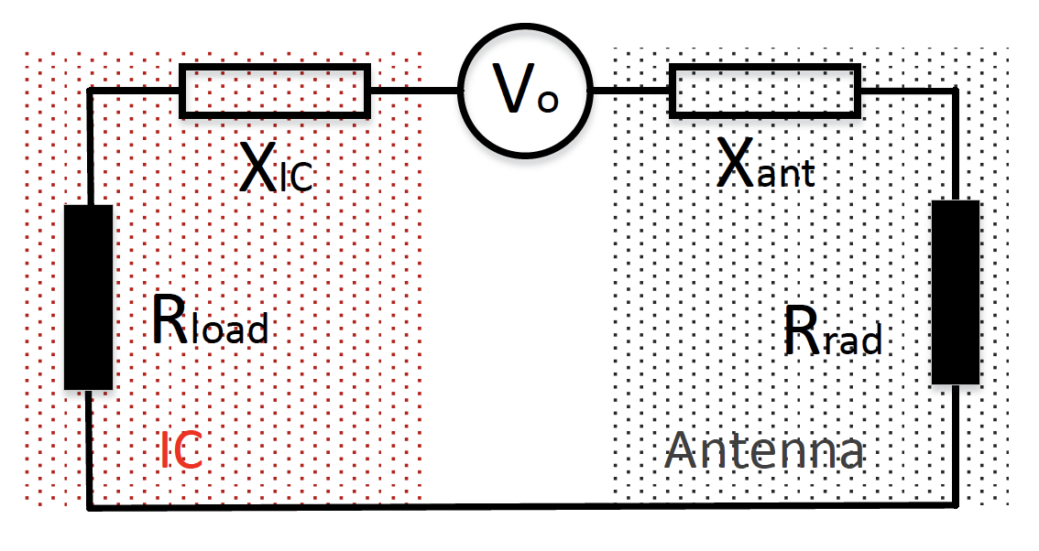
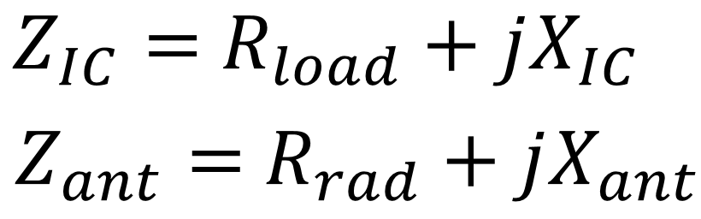

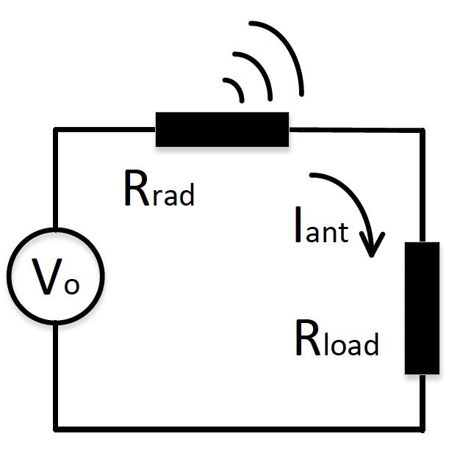
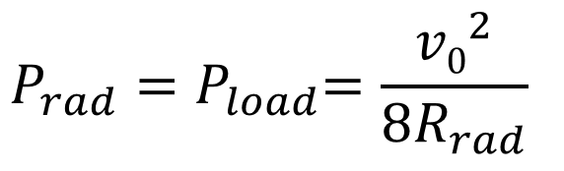
Modeling Tag Coupling
Tag antenna responsibility
Storing charge Capacitance
Opposing changes in current Inductance
Radiating power out Resistance
Equivalent circuit
Reactance: X
IC impedance
Ant impedance
Conjugate
matching
Notes:
//We then construct an equivalent [ɪ'kwɪvələnt] circuit of the tag.
Generally, a tag antenna is responsible of storing charge (capacitance ), opposing changes in current (inductance ), and radiating power out (resistance ). So we can treat the tag antenna as a simplified electric circuit.
In this circuit, a voltage source Vo connects a complex impedance [ɪm‘pidns]. Here V is an open-circuit voltage, arriving from the transmitting signal from the reader, which we can regard as a constant when the tag is in a static system. As we can see in this figure, the impedance part consists a radiation resistance R and a reactance [ri’æktəns] X.
The IC can be similarly modeled.
Generally, for real tags, the antenna is designed to be matched to the IC. In this case, the tag will achieve the best efficiency, and backscatter as much power as that is delivered to the IC.
Based on this, the corresponding scattered power of a single tag can be represented as this equation.

Slide 9
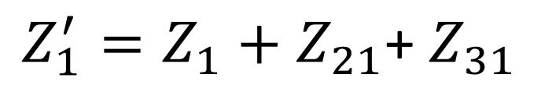
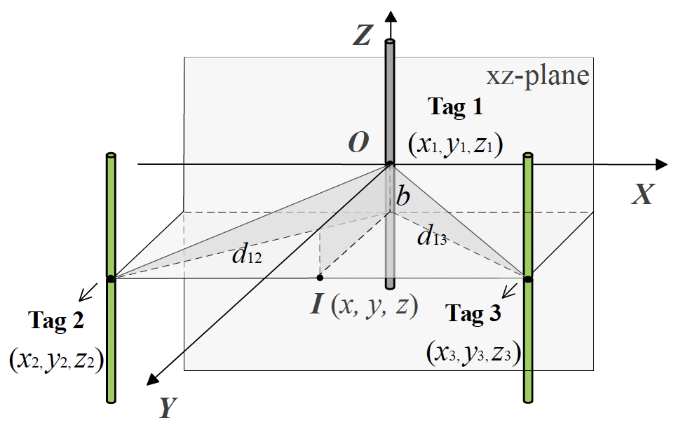

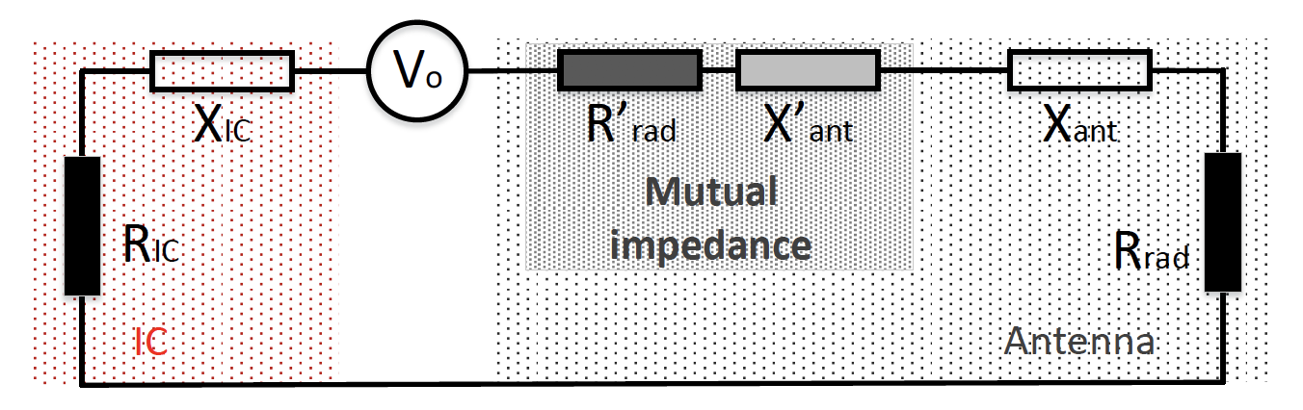
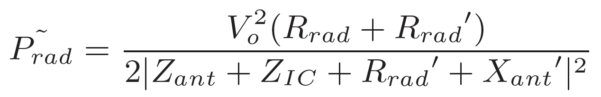
Modeling Tag Coupling
Mutual impedance
Reference
tags
Revised equivalent circuit
Notes:
As mentioned before, when two or more tags are placed close to one another, mutual ['mjutʃuəl] coupling effects will change the structure of the tag antenna, breaking the matched condition.
That is, the impedance of the tag will be not only its self impedance, but also the mutual impedance from other tags.
We build a model to calculate the certain mutual impedance when the reference tags locates at different positions to the target. The details can be found in our paper.
So, when multiple tags exisiting, the scattering power newly yielded can be calculated according to the new impedance and represented as this new equation.

Slide 10
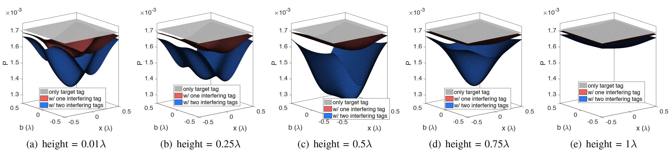
Modeling Tag Coupling
Power spectrum
Significant interference within the wavelength
Generally, closer distance produces larger power decrease
Notes:
Given above analysis, we can simulate the scattering power of the target tag.
This figure shows the power spectrum of the target tag. The grey plane is the value of the case that only the target tag exists in the system, and it locates at the origin ['ɔrɪdʒɪn] of the coordinates.
The red plane is the value of using one reference tag. The blue plane is the value of our proposed Trio, that is, we use two reference tags here.
From this figure, we have following insights:
Firstly, compared to one-reference-tag case, Trio always produces larger power decrease to the target tag.
Secondly, When the height approaches to the wavelength, the mutual coupling derived from the reference tags becomes weak.
Thirdly, in most situations, the closer the reference pair is, the larger power decrease the target tag will experience.
Above insights demonstrate the RF interference among coupled tags and inspires us that we can use this effect to localize the target tag.

Slide 11
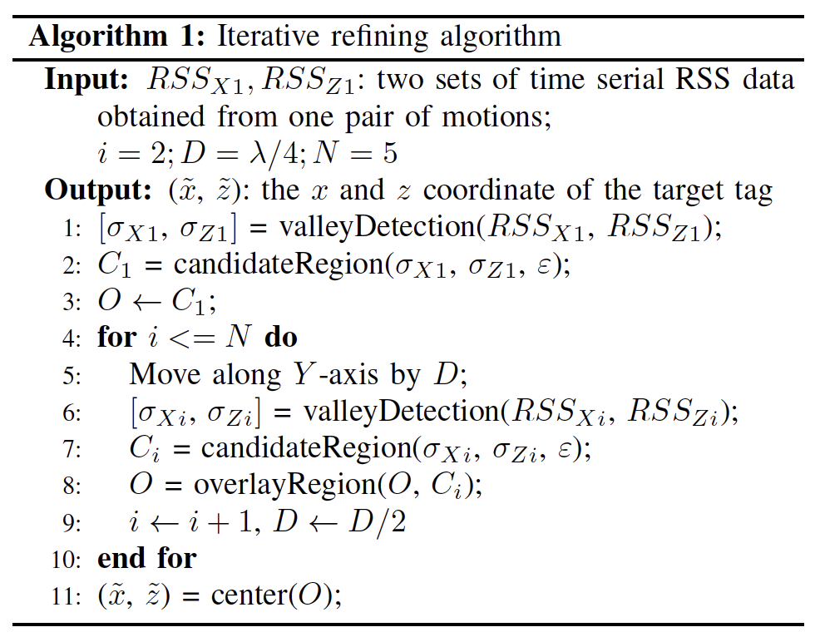
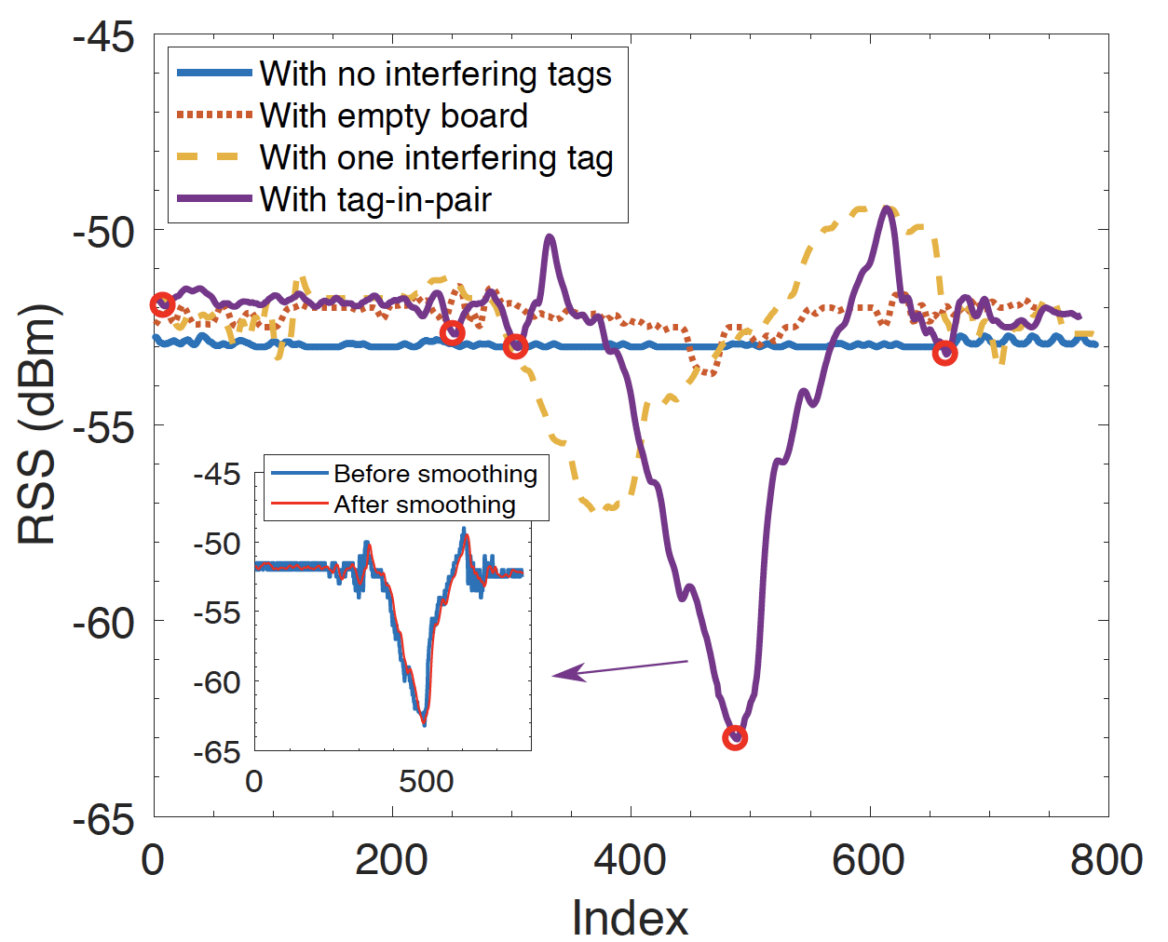
Absolute Localization
Valley detection
Automatic multi-scale based peak detection (AMPD)
Iterative refining
Notes:
After confirming the feasibility of Trio, to localize a target tag, we deploy the reference pair as interfering tags on the manipulator [mə'nɪpjuletɚ].
When the manipulator moves around, we track the RSS of the target to estimate its location. In Theory, the target tag will report the minimum RSS when it locates exactly at the midpoint of two reference tags.
To achieve better reliability, our absolute localization algorithm comprises of two modules, valley detection and iterative ['ɪt(ə)rətɪv] refining.
We move the reference pair straight along two dimensions. After each movement, we use automatic multi-scale based peak detection method to detect the trough of the RSS curve. Given the trough, we can acquire a candidate region. After multiple movements, we can gradually refine the region, and use the overlapped location as the target location.

Slide 12
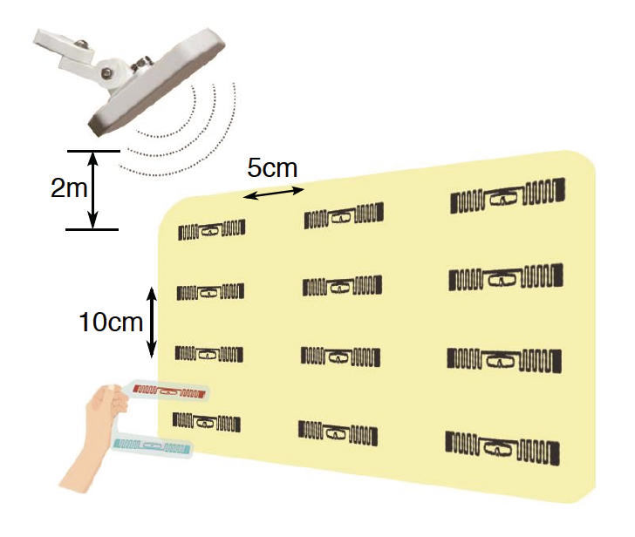
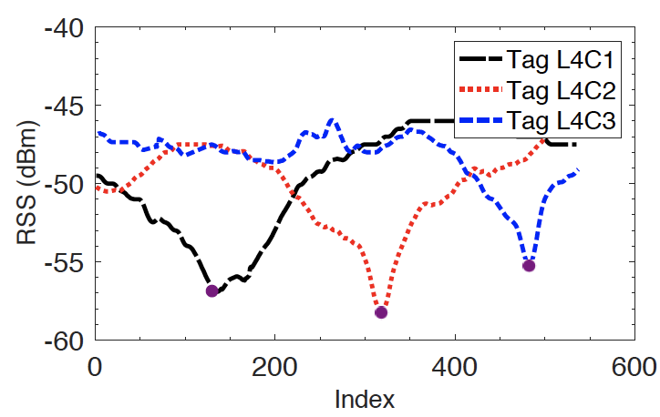
Relative Localization
Valley detection
Temporal information
Notes:
Besides the absolute localization of individual tag, Trio also supports relative localization of a group of tags. That is, determining the order in a 2D plane. A lot of applications can benefit from the knowledge of relative locations, such as finding the misplaced items in the library, store, or production line.
The basic idea of Trio-based relative localization is to move the reference pair over a set of tags.
By analyzing their RSS trends and the temporal information of their valleys, we can get the spatial order among tags.
As this example shows, we deploy a tag array and move the pair along the fourth line, the three tags show sequential valleys, so can easily get their order.

Slide 13

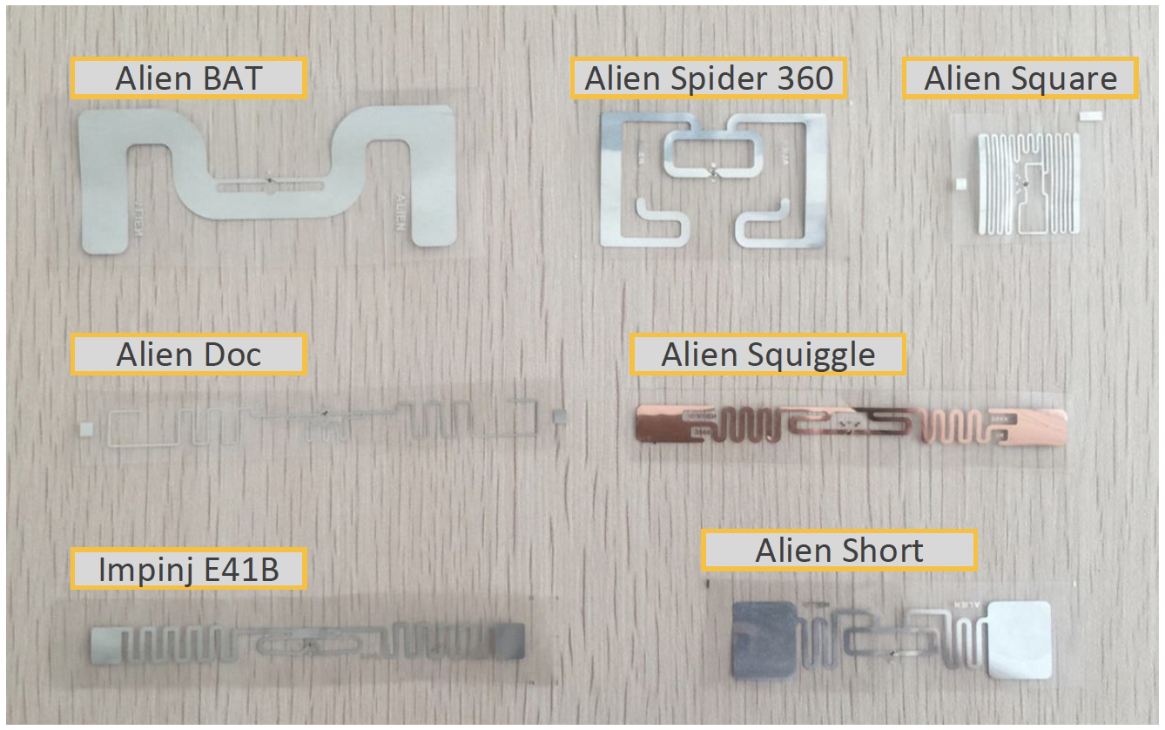
Implementation
Hardware
One Impinj R220 reader
One Laird directional antenna
Seven mainstream types of tags
Software
EPCglobal Low-Level Reader Protocol (LLRP)
C#
Notes:
We implement the whole system purely using commercial off-the-shelf RFID devices, including one impinj R220 reader, one directional antenna, and seven mainstream types of tags.
The software is designed using C#. We adopt LLRP protocol to communicate with the reader.

Slide 14
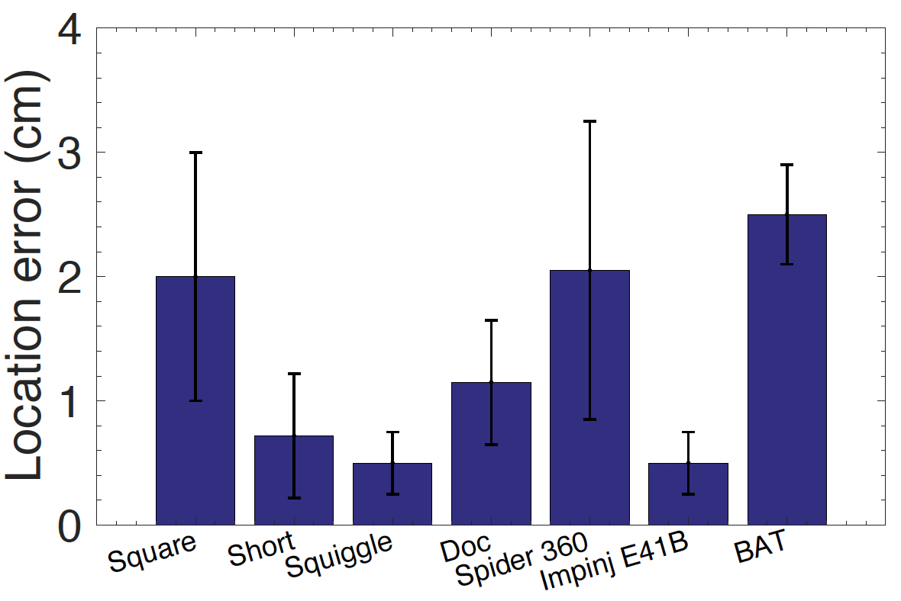
Evaluation
Absolute localization
Overall performance
Trio starts from a random position 30 cm away
Channel 8
Squiggle: 0.5 cm
E41B: 0.5 cm
2.5cm
Notes:
For absolute localization, we deploy different types of tags on a wood table as target tags.
The reference pair starts at a random position 30 cm away from the target tag.
The communication frequency is channel 8.
As the results shown in this figure, the maximum location error is lower than 2.5cm.
For Squiggle ['skwɪgl] and E41B tags, the mean accuracy can reach about 0.5 cm.
We can see that different tags show different accuracy. It is reasonable because tags have different antenna designs, which means they experience different degrees of interference when nearby tags approaches them.

Slide 15
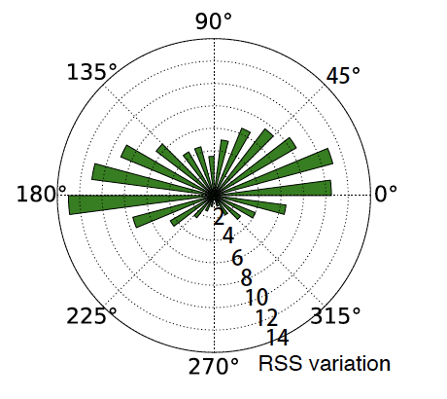
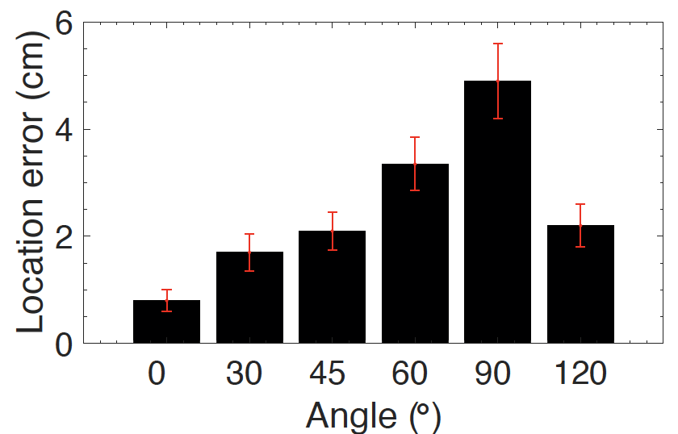
Evaluation
Absolution localization
Overall performance
Angle tolerance
1.9 cm
Notes:
Then we test the tolerance of angle. In practice, the angle between the reference pair and the target tag may not keep an absolute parallel deployment.
Thus, we first estimate the impact of angle to the RSS variation. As the left figure shows, the largest RSS drop happens when tags are parallel, which means the maximum interference. And the interference becomes slight when the angle approaches 90 degrees.
We further test the impact of angle to localization accuracy. As expected, the error gradually increases when enlarging the angle. However, if the angle is less than 45 degrees, the average error can still achieve 1.9cm.

Slide 16
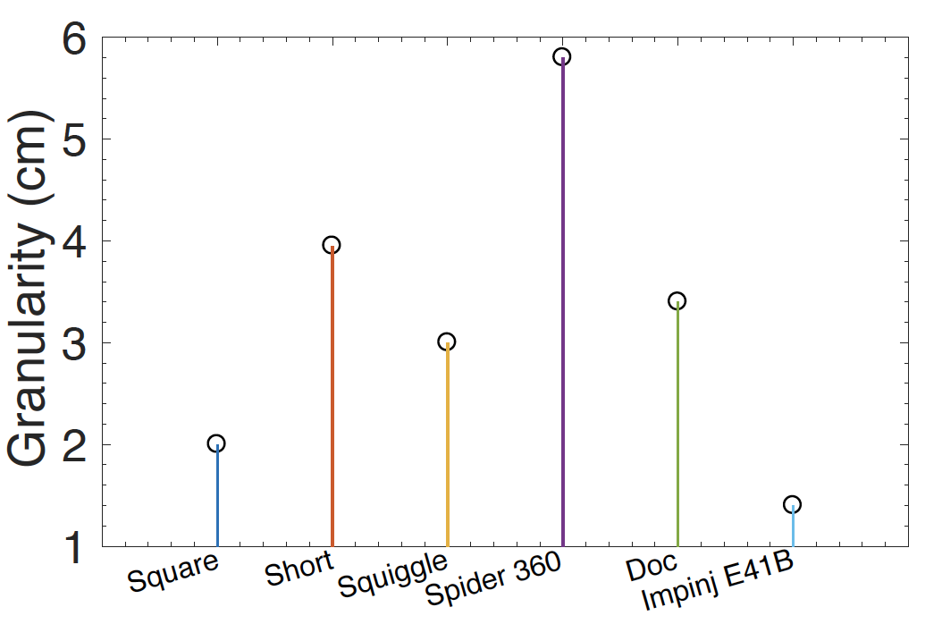
Evaluation
Relative localization
Granularity distance among target tags
Transmitting power: 25 dBm
Channel 8
Spider 360 > 6 cm
Square > 2 cm
E41B > 2 cm
>6 cm
2 cm
Notes:
In this group of experiments, we evaluate the performance of relative localization.
When determining the order among tags, it is worth to consider the distance between adjacent [ə'dʒesnt] target tags. we investigate the minimum distance between target tags that Trio still can support the order detection.
We deploy a 4 line 3 column tag array, and increase the distance interval between them with a step length of 0.5cm.
This figure shows the result: spider tag achieves good performance when the distance is larger than 6cm. ‘Square’ and ‘Impinj E41B’ tags can support order determination even they are densely deployed (closer than 2 cm).
Above results provide suggestion of tag selection for various applications.

Slide 17
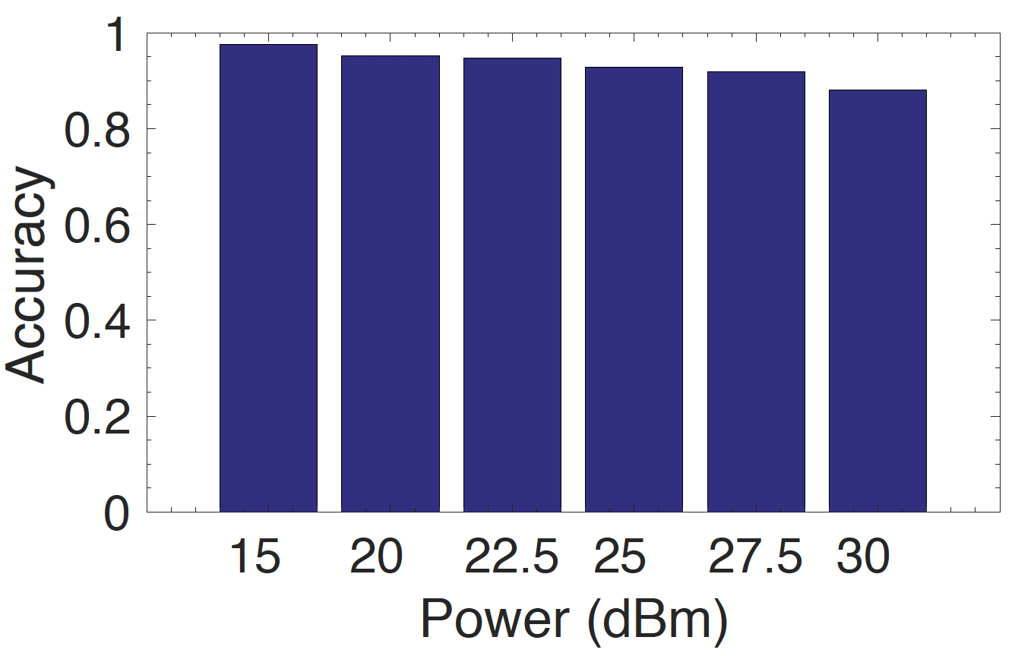
Evaluation
Relative localization
Granularity distance among target tags
Order accuracy vs. power
4 X 3 Doc tag
98%
88%
Notes:
Next, let’s see the order accuracy versus reader transmitting power.
We change the power from 15 to 30 dbm and observe the order accuracy. The results shown in this figure indicates that the accuracy decreases slightly when the power increases. We envision the reason is that larger power might introduce more multipath effects to tags, which reduces the order accuracy.
This result reveal that for different deployment environment, we should set the power properly, which could help to increase system efficiency.

Slide 18
Conclusion
Low-cost solution for accurate refined localization using coupling among nearby tags
Implemented purely based on COTS RFID products
Complement with vision-based localization methods
Notes:
Let me make a conclusion.
We propose a system namely Trio, a low-cost solution for accurate refined localization, which uses coupling among nearby tags.
We implement the prototype purely based COTS RFID products.
Our system can nicely complement vision-based localization methods.
RFID tags can easily provide the identity information, and locations can bridge the identities and the visual objects.

Slide 19
Thank you !

